Slide 1
Fourier Transforms
Da Zhou (周 达)
zhouda@xmu.edu.cn

Slide 2
Fourier series revisited ( with period T )

Slide 3
Fourier series revisited ( with period T )

Slide 4
Fourier series revisited ( with period T )

Slide 5
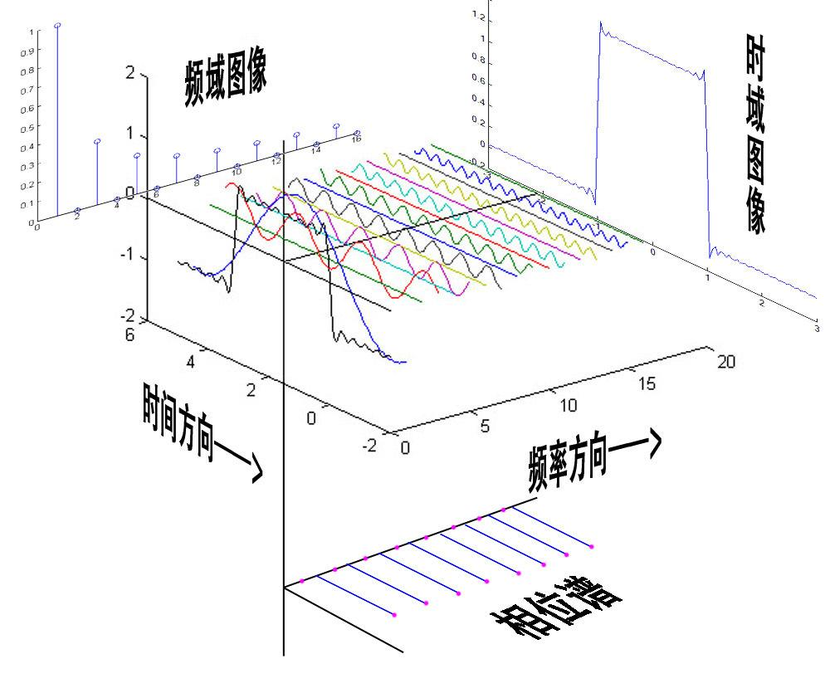

Slide 6
Complex form of Fourier series ( with period T )

Slide 7
Orthogonality relation

Slide 8
Orthogonality relation

Slide 9

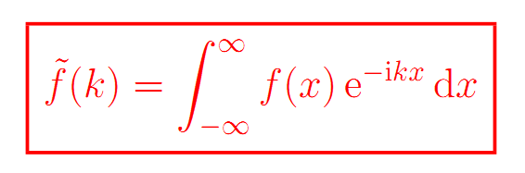
Forward Fourier transform

Slide 10
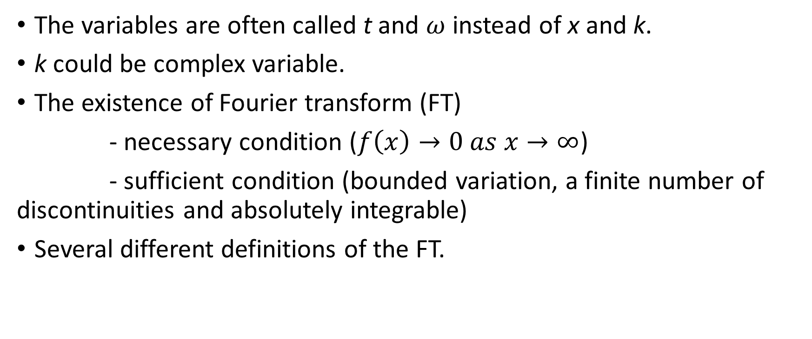
Remarks
The variables are often called t and $ω$ instead of x and k.
k could be complex variable.
The existence of Fourier transform (FT)
- necessary condition ($f\left(x\right)→0 as x→∞$)
- sufficient condition (bounded variation, a finite number of discontinuities and absolutely integrable)
Several different definitions of the FT.

Slide 11

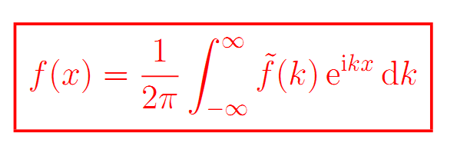
Inverse Fourier transform

Slide 12
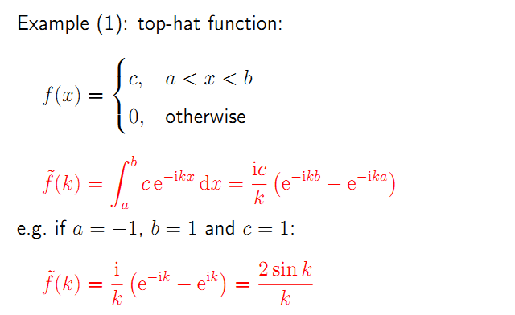

Slide 13
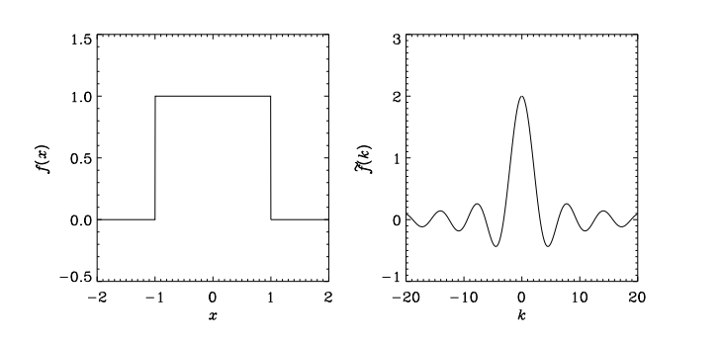

Slide 14
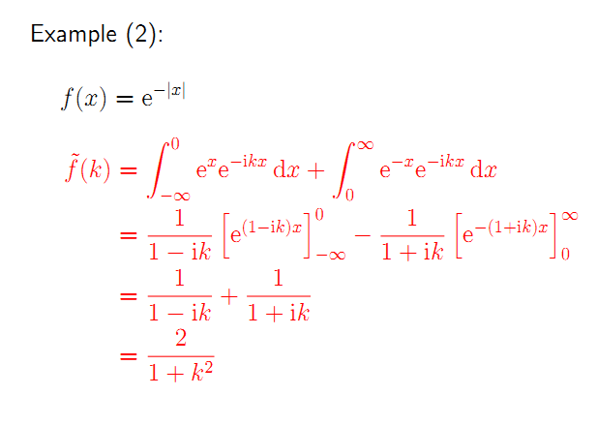

Slide 15
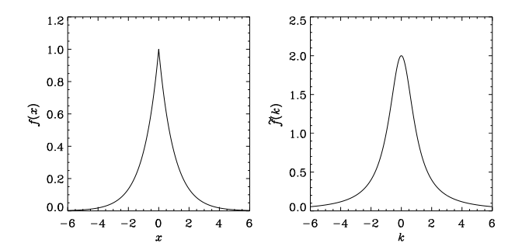

Slide 16
Is there any function that could be equal to its FT?

Slide 17
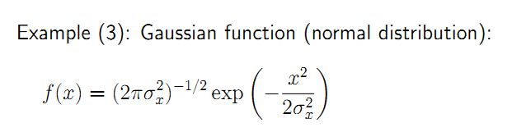

Slide 18
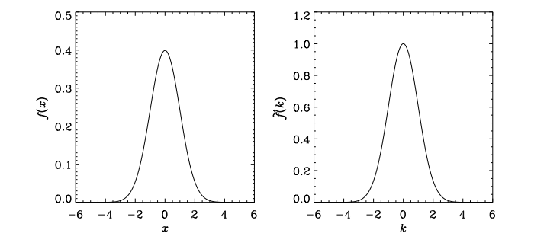

Slide 19
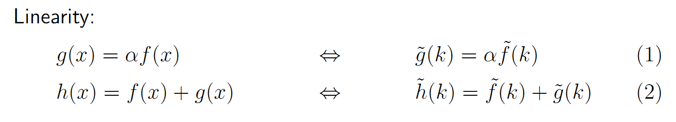
Basic properties of the Fourier transform

Slide 20
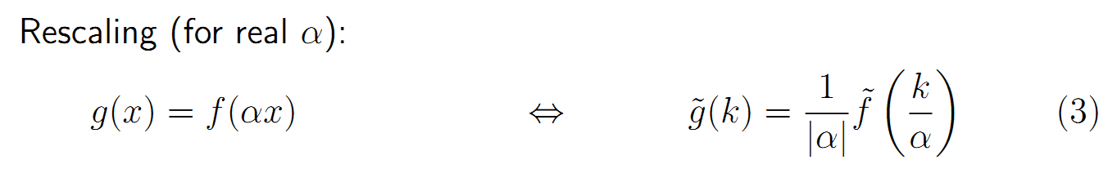
Basic properties of the Fourier transform

Slide 21
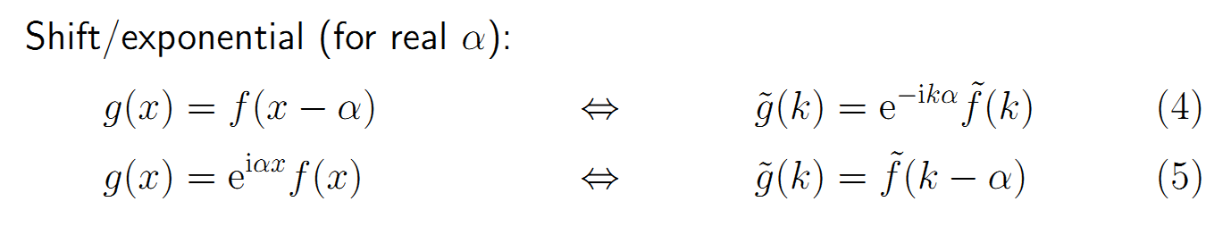
Basic properties of the Fourier transform

Slide 22
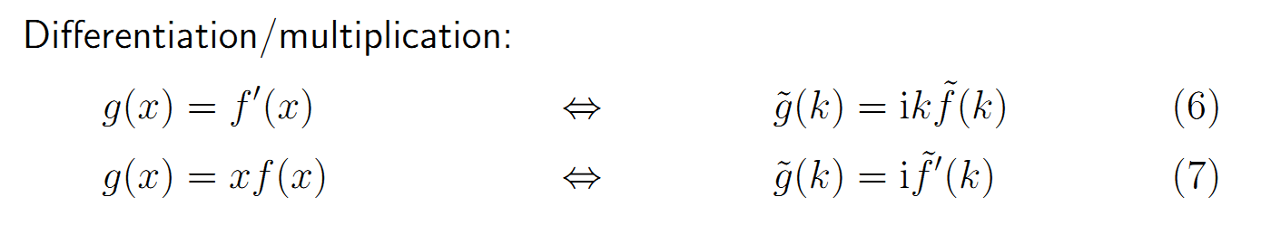
Basic properties of the Fourier transform

Slide 23
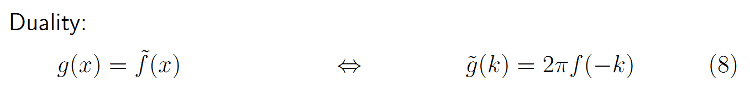
Basic properties of the Fourier transform

Slide 24
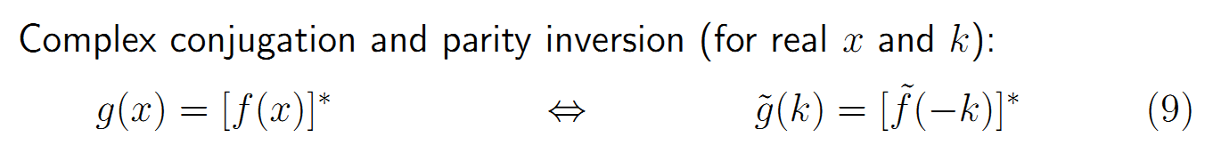
Basic properties of the Fourier transform

Slide 25
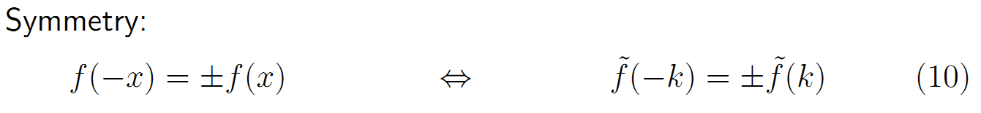
Basic properties of the Fourier transform

Slide 26


Dirac delta function

Slide 27
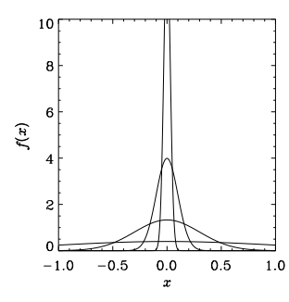
Dirac delta function

Slide 28


Dirac delta function

Slide 29
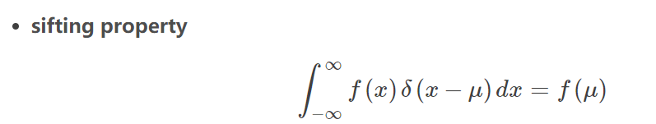
Dirac delta function

Slide 30
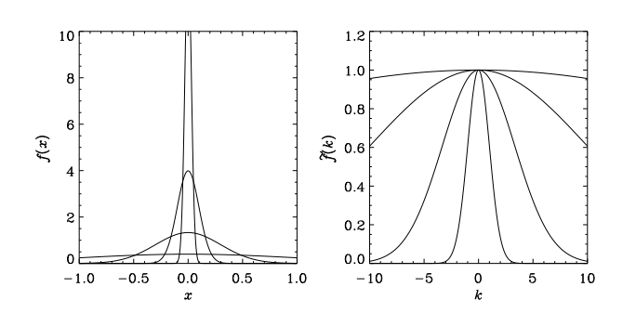
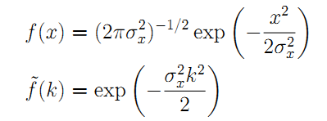
Fourier transform for Dirac delta function

Slide 31
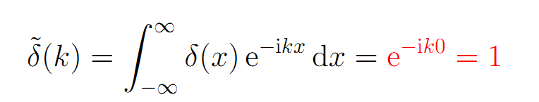
Fourier transform for Dirac delta function

Slide 32
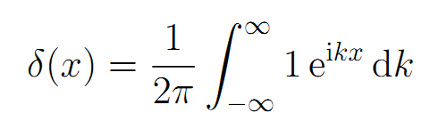
Fourier transform for Dirac delta function

Slide 33
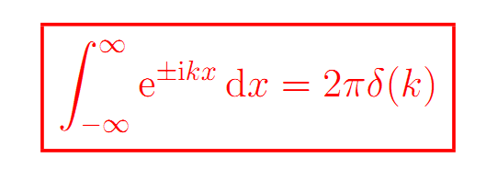
Fourier transform for Dirac delta function

